Slide 1
Introduction to Quantum Computing: From a Layperson to a Programmer in 30 Steps
Hiu-Yung Wong
https://link.springer.com/book/10.1007/978-3-030-98339-0
https://www.amazon.com/Introduction-Quantum-Computing-Layperson-Programmer/dp/3030983382
Playlist: https://www.youtube.com/watch?v=wyenXYGu51o&list=PLnK6MrIqGXsJfcBdppW3CKJ858zR8P4eP&index=58

Slide 2
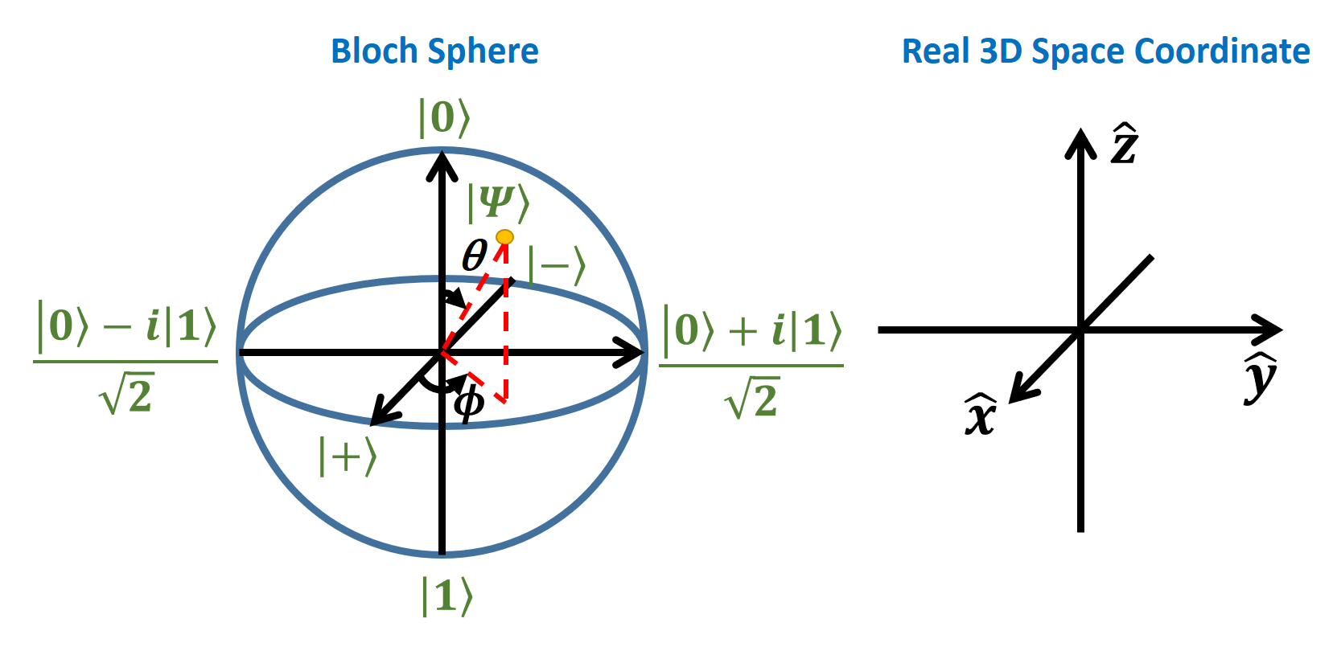
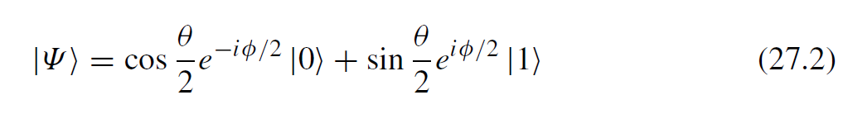
Embedding C² space in 3D space

Slide 3
Exponentiation of matrix

Slide 4
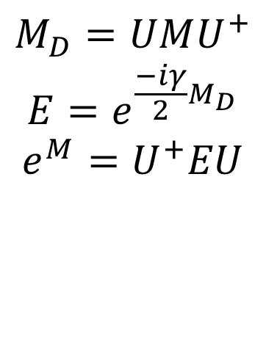

Matrix in Exponent – non-Diagonal Case
$$e^{\frac{−iγ}{2}M}=\sum_{n=0}^{∞}{\frac{1}{n!}{\left(\frac{−iγ}{2}\right)}^{n}M^{n}}$$
Or: Diagonalize it, take exponent, transform back
$$M_{D}=UMU^{+}$$
$$E=e^{\frac{−iγ}{2}M_{D}}$$
$$e^{M}=U^{+}EU$$
Note: for any matrix M, M⁰ = I

Slide 5
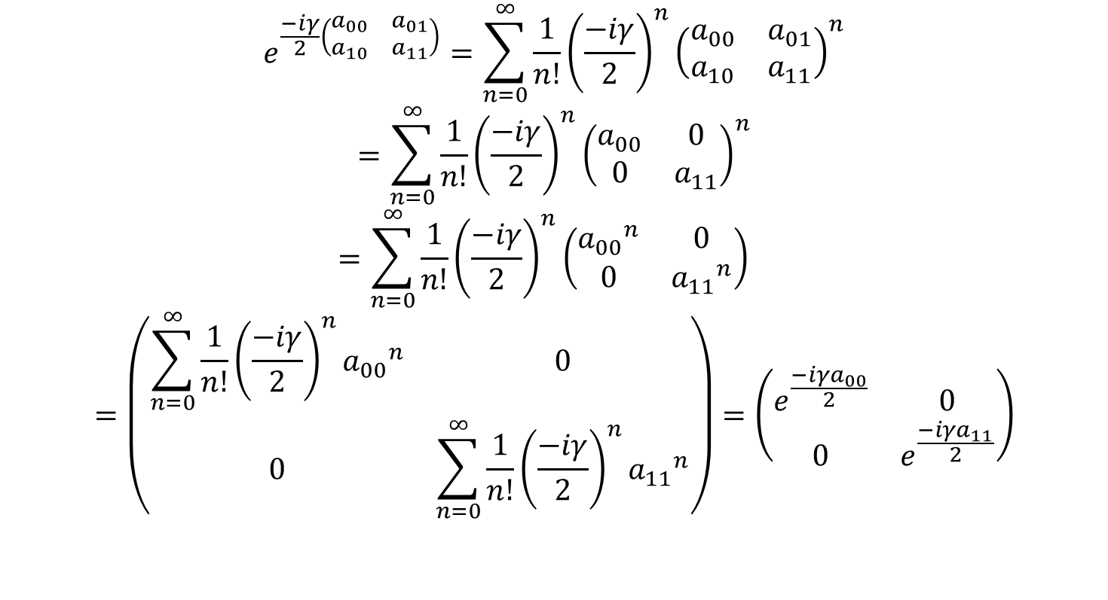
Matrix in Exponent – Diagonal Case
$$e^{\frac{−iγ}{2}\left(\begin{matrix}a_{00} & a_{01} \\ a_{10} & a_{11}\end{matrix}\right)}=\sum_{n=0}^{∞}{\frac{1}{n!}{\left(\frac{−iγ}{2}\right)}^{n}{\left(\begin{matrix}a_{00} & a_{01} \\ a_{10} & a_{11}\end{matrix}\right)}^{n}}$$
$$=\sum_{n=0}^{∞}{\frac{1}{n!}{\left(\frac{−iγ}{2}\right)}^{n}{\left(\begin{matrix}a_{00} & 0 \\ 0 & a_{11}\end{matrix}\right)}^{n}}$$
$$=\sum_{n=0}^{∞}{\frac{1}{n!}{\left(\frac{−iγ}{2}\right)}^{n}{\left(\begin{matrix}{a_{00}}^{n} & 0 \\ 0 & {a_{11}}^{n}\end{matrix}\right)}^{}}$$
$$=\left(\begin{matrix}\sum_{n=0}^{∞}{\frac{1}{n!}{\left(\frac{−iγ}{2}\right)}^{n}}{a_{00}}^{n} & 0 \\ 0 & \sum_{n=0}^{∞}{\frac{1}{n!}{\left(\frac{−iγ}{2}\right)}^{n}}{a_{11}}^{n}\end{matrix}\right)=\left(\begin{matrix}e^{\frac{−iγa_{00}}{2}} & 0 \\ 0 & e^{\frac{−iγa_{11}}{2}}\end{matrix}\right)$$
If the matrix is diagonal

Slide 6
Rotation on Bloch Sphere: How many degrees to go back to the origin

Slide 7
Schroedinger Equation and Qubit Manipulation

Slide 8
Evolution of Qubit

